Slide 1

Natural Disaster Data Analysis
Earthquake
Landslide
Volcanoes
Storm
Flood
Wild Fire

Slide 2
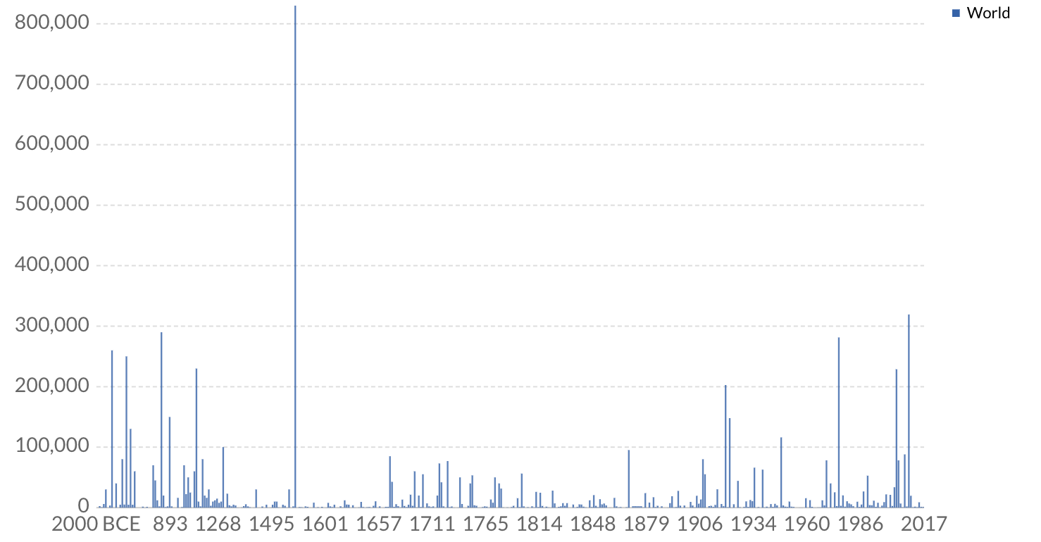
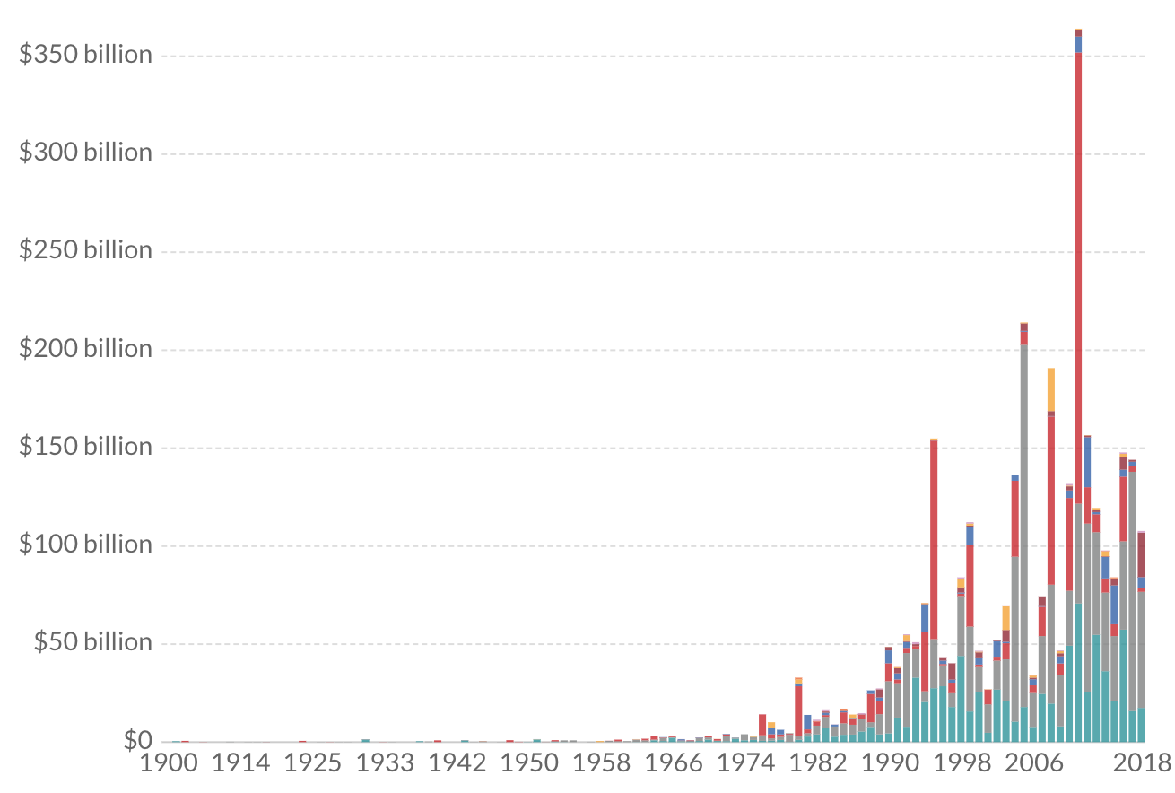
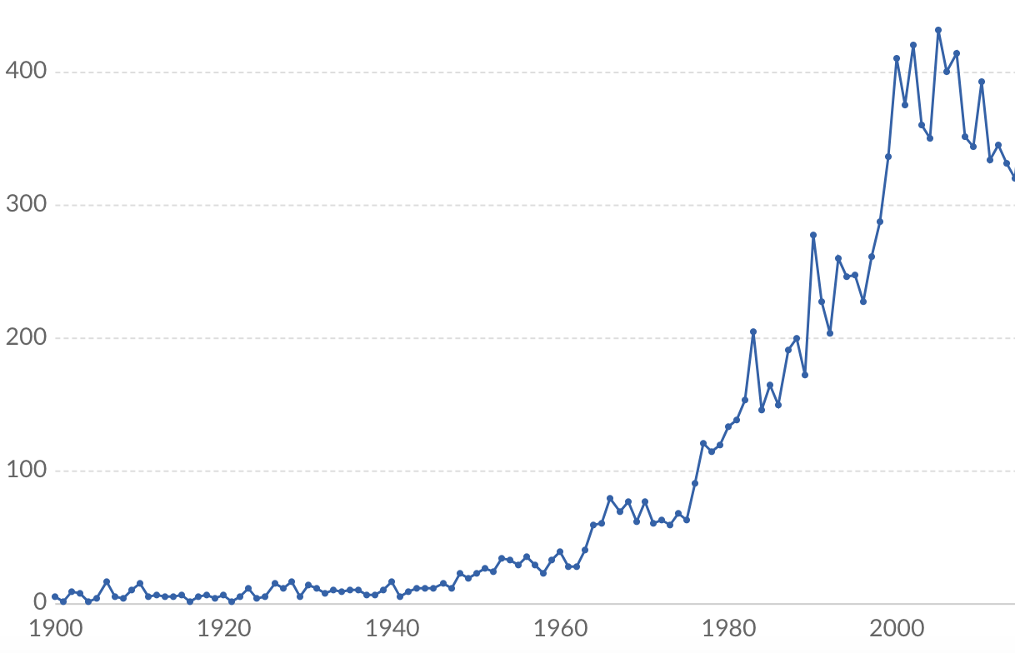
Natural Disaster Data Analysis
Period
From To
Filter by Country
Filter by Disaster Type
View Global Map
Estimated number of deaths
Economic damage by natural disaster
United states of America
Earthquake
Occurance of Natural disaster

